Slide 1
1주차 논문리뷰 Deep Learning and Time Series-to-Image Encoding

Slide 2
Introduction
Financial Forecasting using Ensemble of CNNs
Time series data를 분석하기 위한 ML/DL방법들이 많이 연구되고 있음
RNN, SVM, ANN with DT (hybrid approach)
CNN models
DL쪽에서 광범위하게 연구되고 좋은 성능을 보여주는 모델이 많이 개발됨
그러나 image data가 아닌 time series data를 처리하기에는 적절하지 않음
Proposed Approachs
GAF (Gramian Angular Field) image
time series -> normalization -> GAF image
Multi-resolution aggregation for data granularity
Ensemble of CNNs
majority voting-based prediction policy

Slide 3
Problem definition
Goal
Achieve market prediction over S&P 500 index
Trading strategy
Long action
Short action
Hold action
majority voting에서 결론이 나지 않은 경우

Slide 4
S&P500 index dataset
S&P500
S&P500 index is one of the most widely traded index future contracts in the United States and it is computed by multiplying the S&P500 value by $50
Data configuration
16 years and 4569 observations (in which financial market has been opened)
Available data
Date of the observation (mm/dd/yyyy)
Interval of the observation (hh:mm:ss)
Open / Close
High / Low
=> Close - Open value : 1 (positive) or 0 (otherwise)

Slide 5
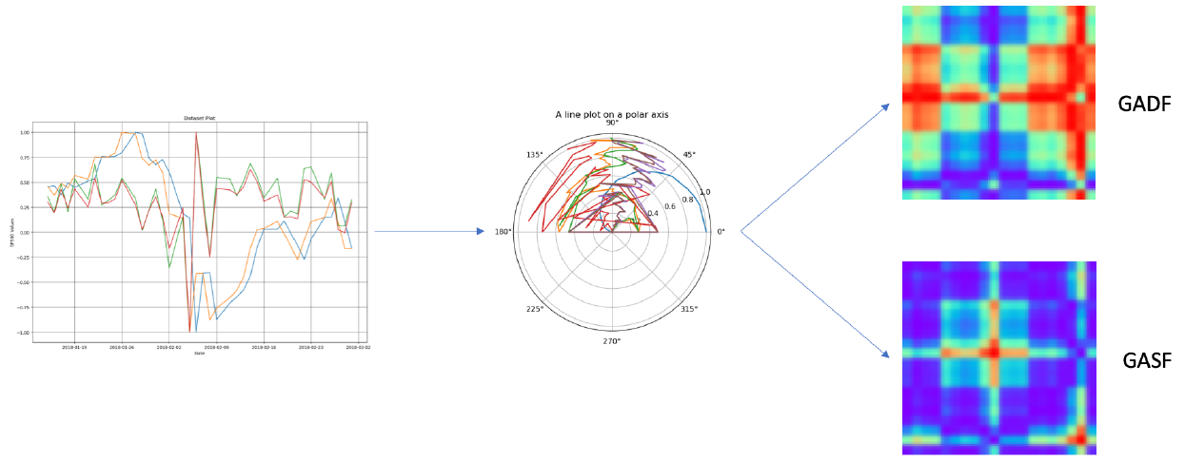
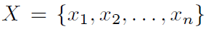
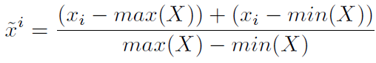
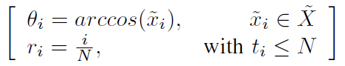
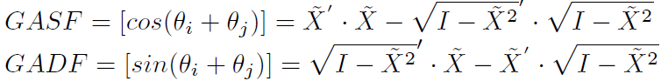
Gramian Angular Field
Data processing
original data
normalization: scaling to interval [-1, 1]
transformation to polar coordinate system
GAF images

Slide 6
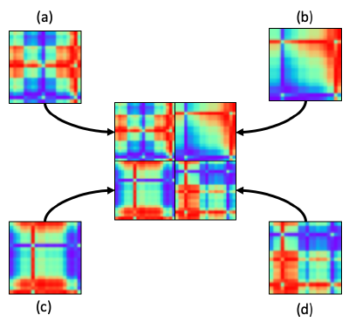
Multi-resolution aggregating
Data processing
Original S&P500 time series data
observations sampled at intervals of 5 minutes
4 new intervals
1 hours / 4 hours / 8 hours / 24 hours
Select 20 samples for predicting market-day after
each 20 samples -> 20 * 20 * 3 GADF image
Make 40 * 40 * 3 GADF image

Slide 7
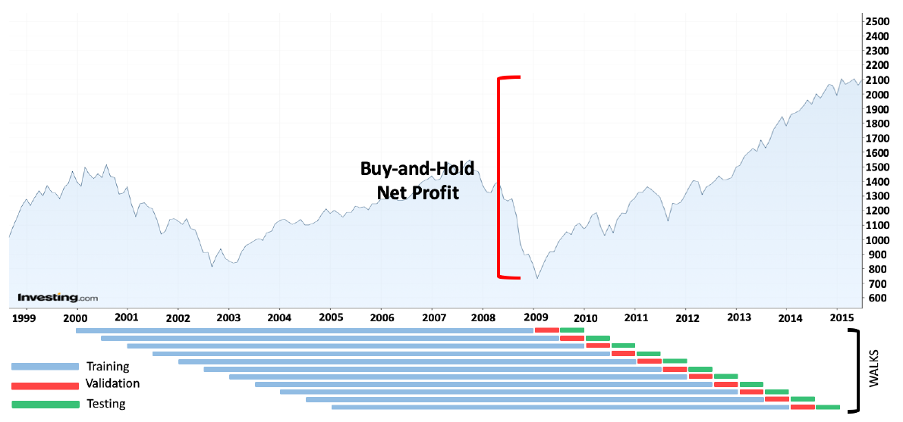
Walk-forward validation

Slide 8
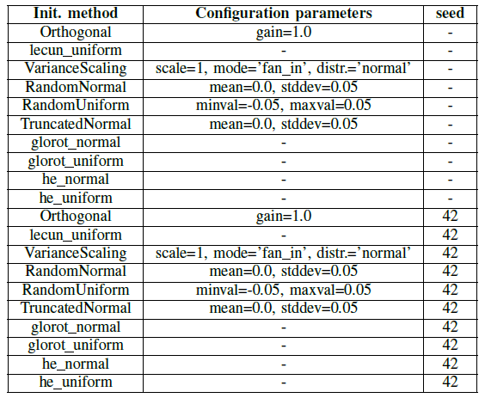
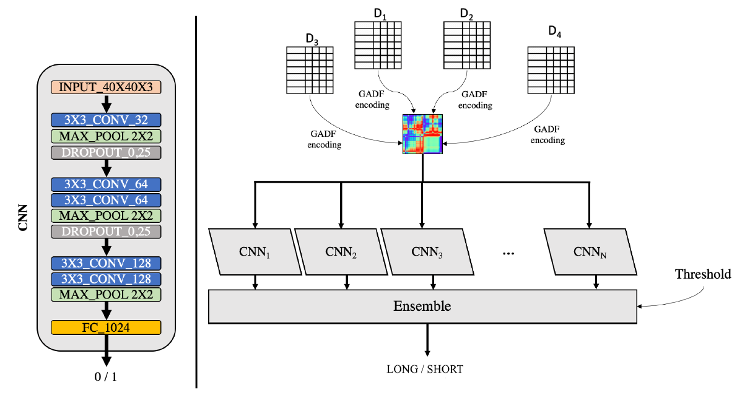
Ensemble of CNNs
Model architecture
Simplified VGG
Consists of 5 Conv layers and one FC layer
20 models
different weights initialization

Slide 9
Test setting
Metrics
Net Profit
Annualized sharpe ratio
Sortino ratio
RoMaD (Return Over Maximum Drawdown)
Comparison target
B&H strategy
Random Guessing (random predictor)
1D - CNN
does not apply GAF transformation

Slide 10
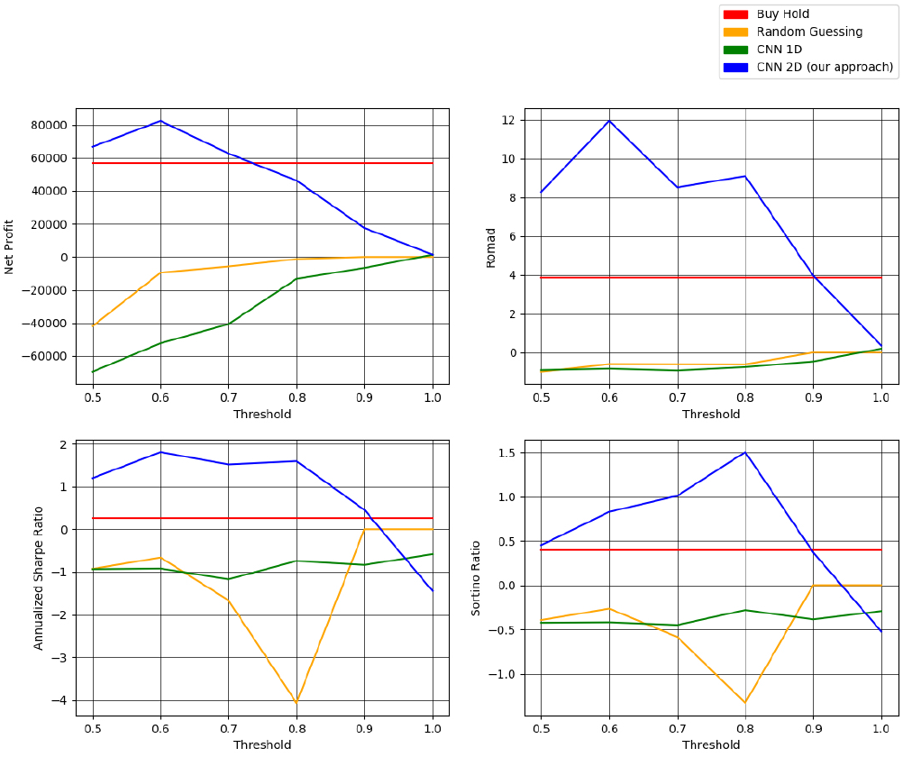
Results

Slide 11
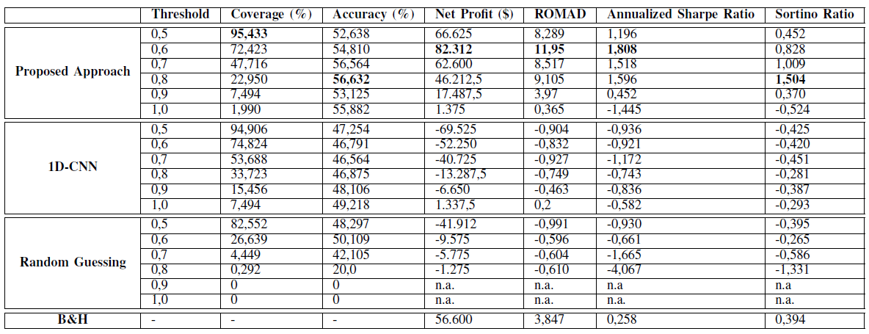
Results

Slide 12
END

